Slide 1





Visual Exploration of Relationships and Structure in Low-Dimensional Embeddings
Klaus Eckelt, Andreas Hinterreiter, Patrick Adelberger, Conny Walchshofer, Vaishali Dhanoa, Christina Humer, Moritz Heckmann, Christian A. Steinparz, Marc Streit
klaus.eckelt@jku.at
@klaus_lml
https://jku-vds-lab.at/biovis22-eckelt

Slide 2
Motivation
Patients
Tumor Type
Age
Expression
Mutation
…
😐
😐
😐
☹
🙁
🙁
Tumor
Type
…
😐
😐
😐
☹
🙁
🙁
😐
😐
😐
☹
🙁
🙁
…
…
…
…
…

Slide 3
Motivation
Patients
😐
🙁
☹
😐
😐
🙁
☹
🙁
Tumor
Type
🙁
😐
😐
🙁
🙁
🙁
😐
🙁
🙁
☹
😐
😐
☹
🙁
☹
😐
🙁
🙁
🙁
Gene Mutation
☹
☹
☹

Slide 4
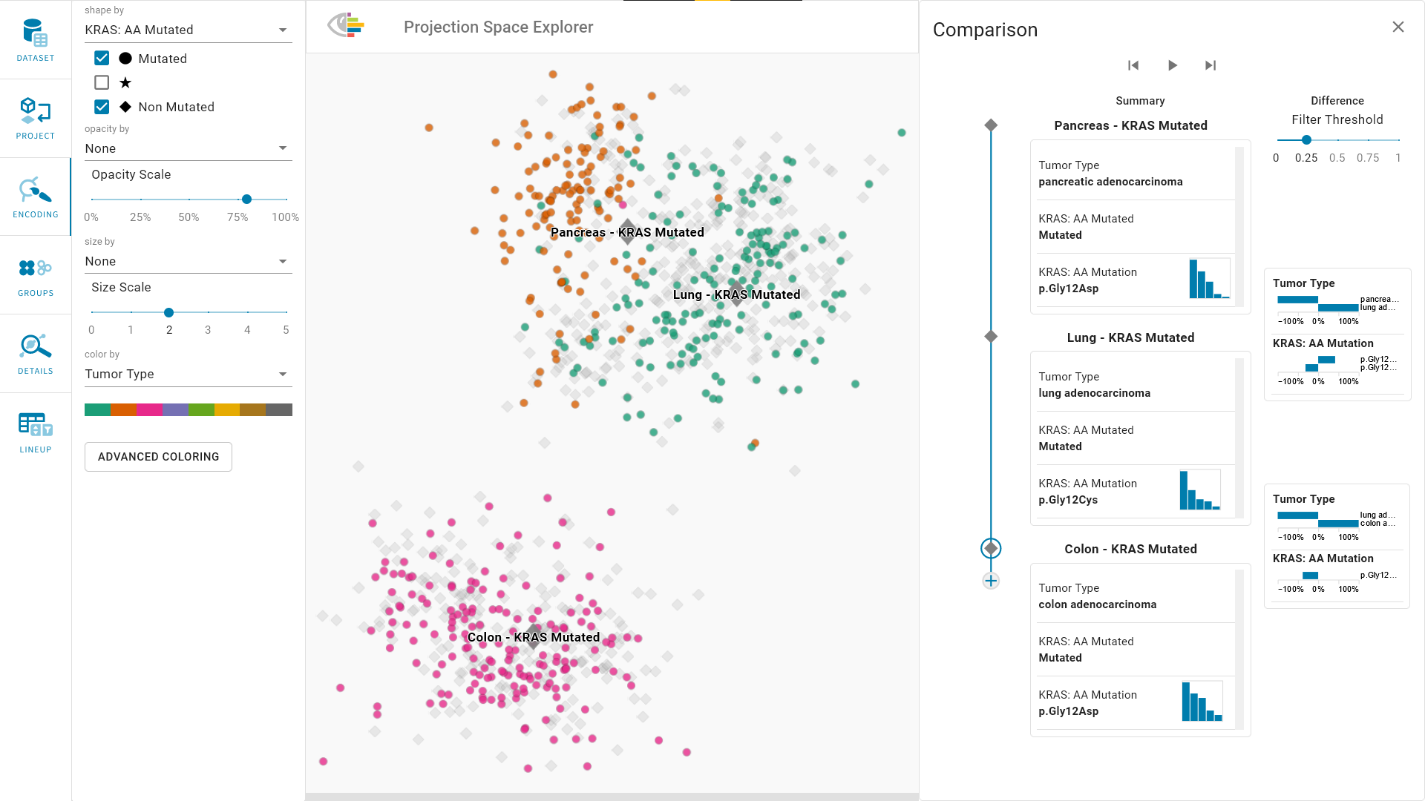
https://jku-vds-lab.at/biovis22-eckelt

Slide 5
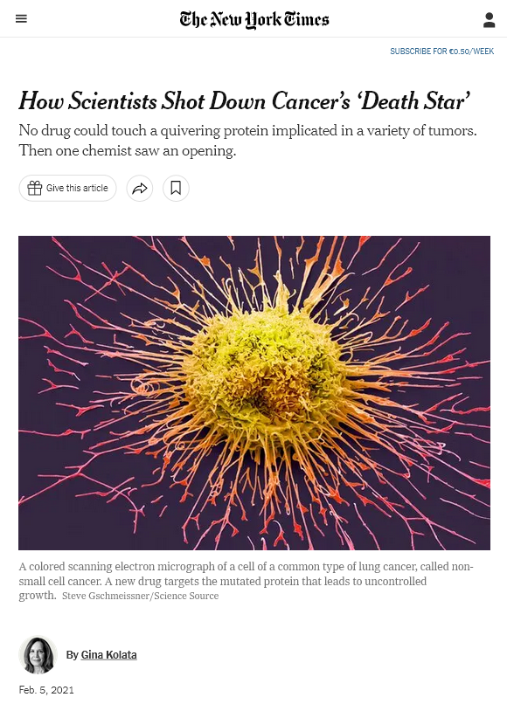
Use Case
Treatment for cancer patients with KRAS G12C mutations.
Data: TCGA
Lung
Colon
Pancreatic
G. Kolata, “How Scientists Shot Down Cancer’s ‘Death Star’,” The New York Times, Feb. 2021 National Cancer Institute, “The cancer genome atlas program,” 2019

Slide 6
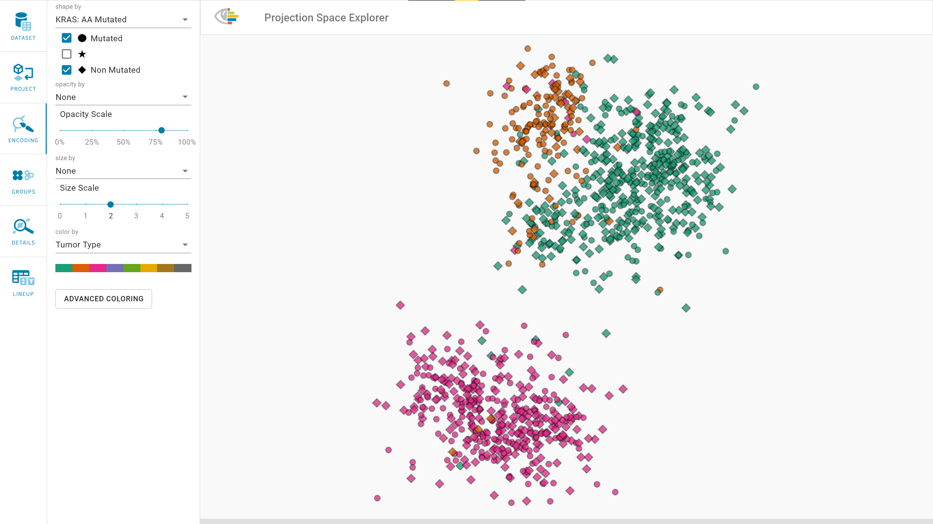
https://jku-vds-lab.at/biovis22-eckelt

Slide 7
Representing Structure

Slide 8
Representing Structure
Groups

Slide 9
Representing Structure
Groups

Slide 10
Defining Structure
Single Items
Groups
By User Selection
By Clustering
By (Meta-) Data
Tumor Type
Age
Expression
Mutation
…
…
…
…
…
…
…

Slide 11
Representing Relationships: Group⮕Group
Hierarchies
Graphs

Slide 12
Representing Relationships: Item⮕Group

Slide 13
Representing Relationships: Item⮕Group

Slide 14
Representing Relationships: Item⮕Group
Selected points are connected with their groups’ centroids.

Slide 15
Representing Relationships: Item⮕Group⮕Item

Slide 16
Representing Relationships: Item⮕Group⮕Item
Star Visualization
Contour Plot

Slide 17
Representing Relationships: Item Sequences
Regimen 1
Regimen 2
Regimen 3

Slide 18
Representing Relationships: Group Sequences
Regimen 1
Regimen 2
Regimen 3

Slide 19
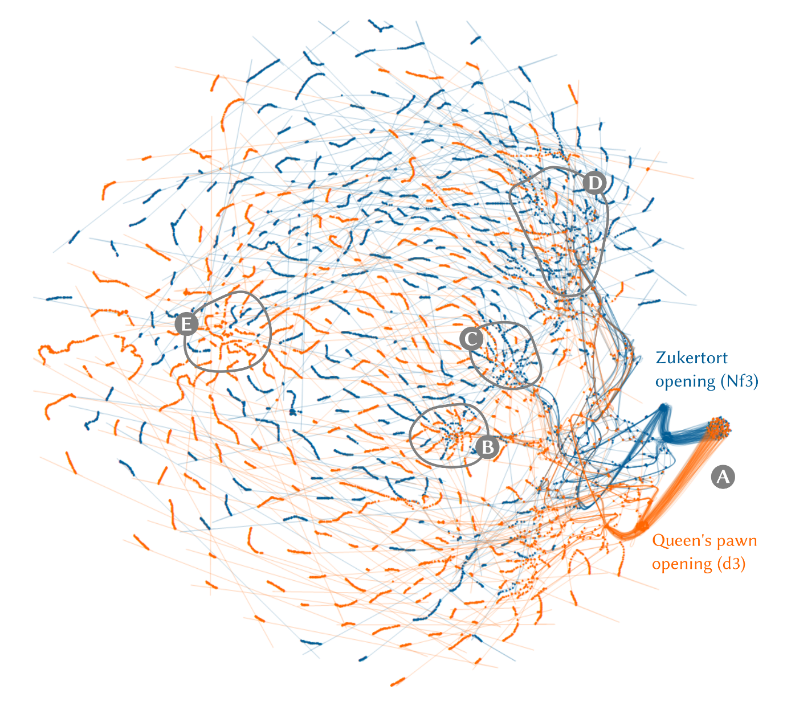
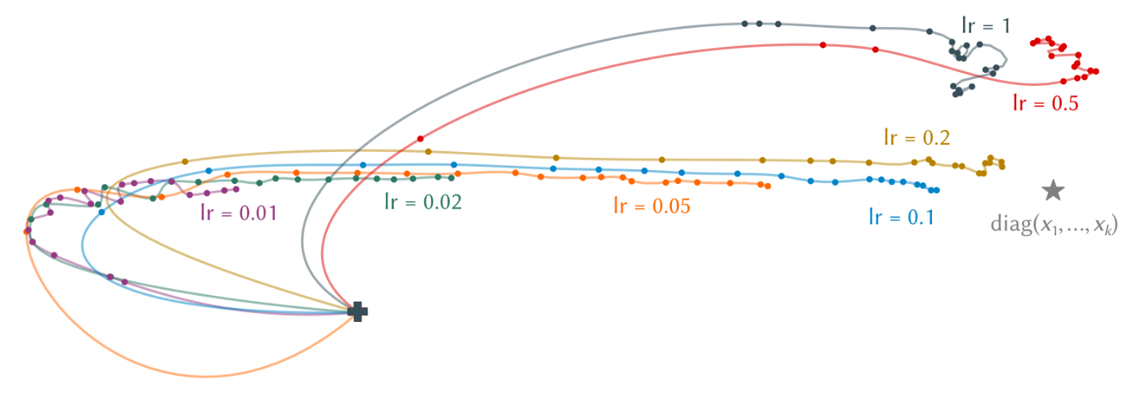
Sequential Data
Chess
Neural Networks
A. Hinterreiter, C. Steinparz, M. Schöfl, H. Stitz, and M. Streit, “Projection Path Explorer: Exploring Visual Patterns in Projected Decision-Making Paths,” ACM Transactions on Interactive Intelligent Systems, vol. 11, no. 3–4, p. Article 22, 2021.

Slide 20
Visual Exploration of Relationships and Structure in Low-Dimensional Embeddings

Slide 21
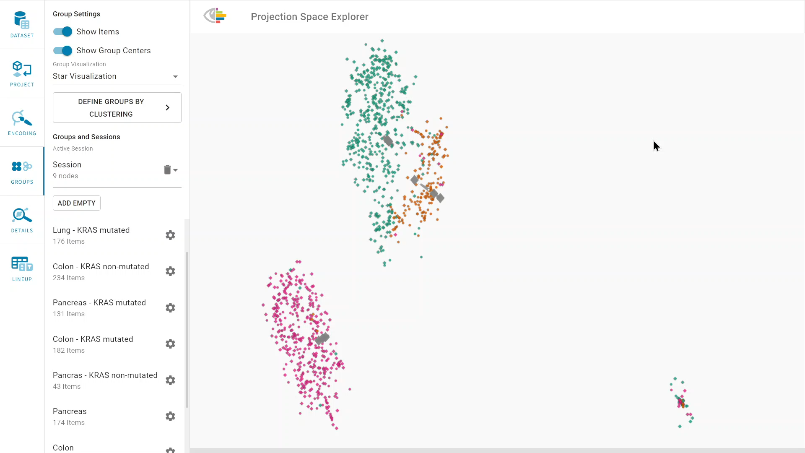
Video: Mutation

Slide 22
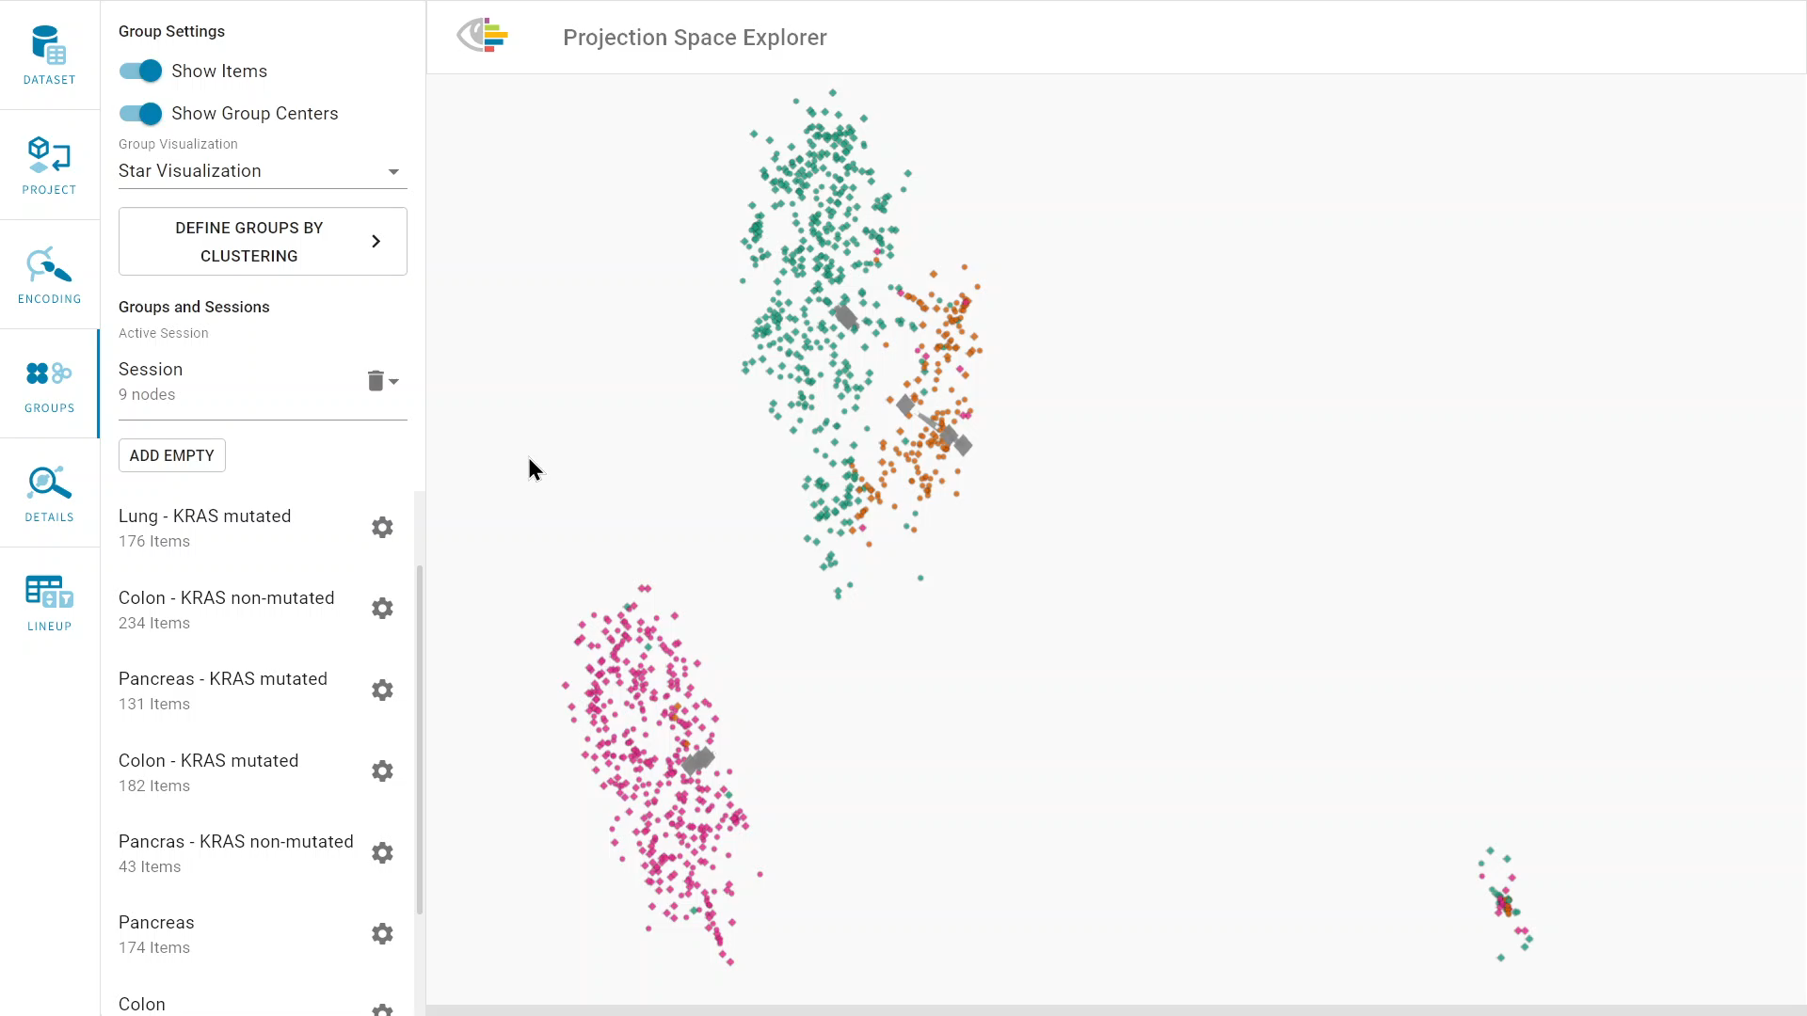
Video: Expression

Slide 23
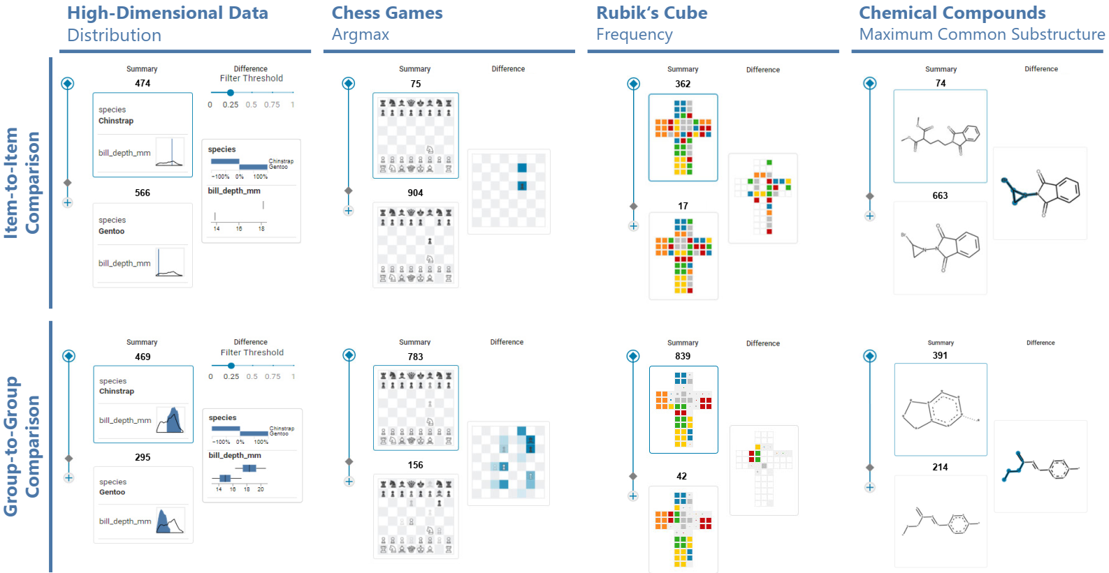
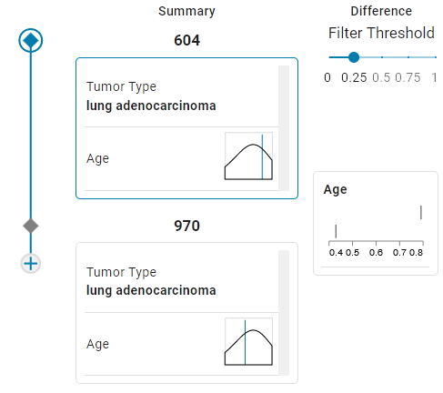
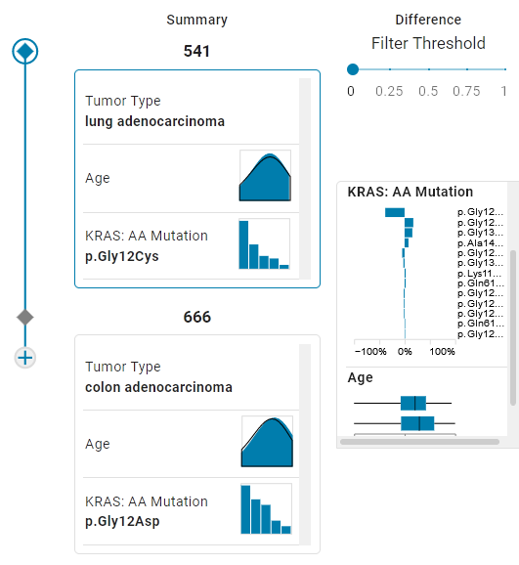
Summary and Difference Visualizations

Slide 24
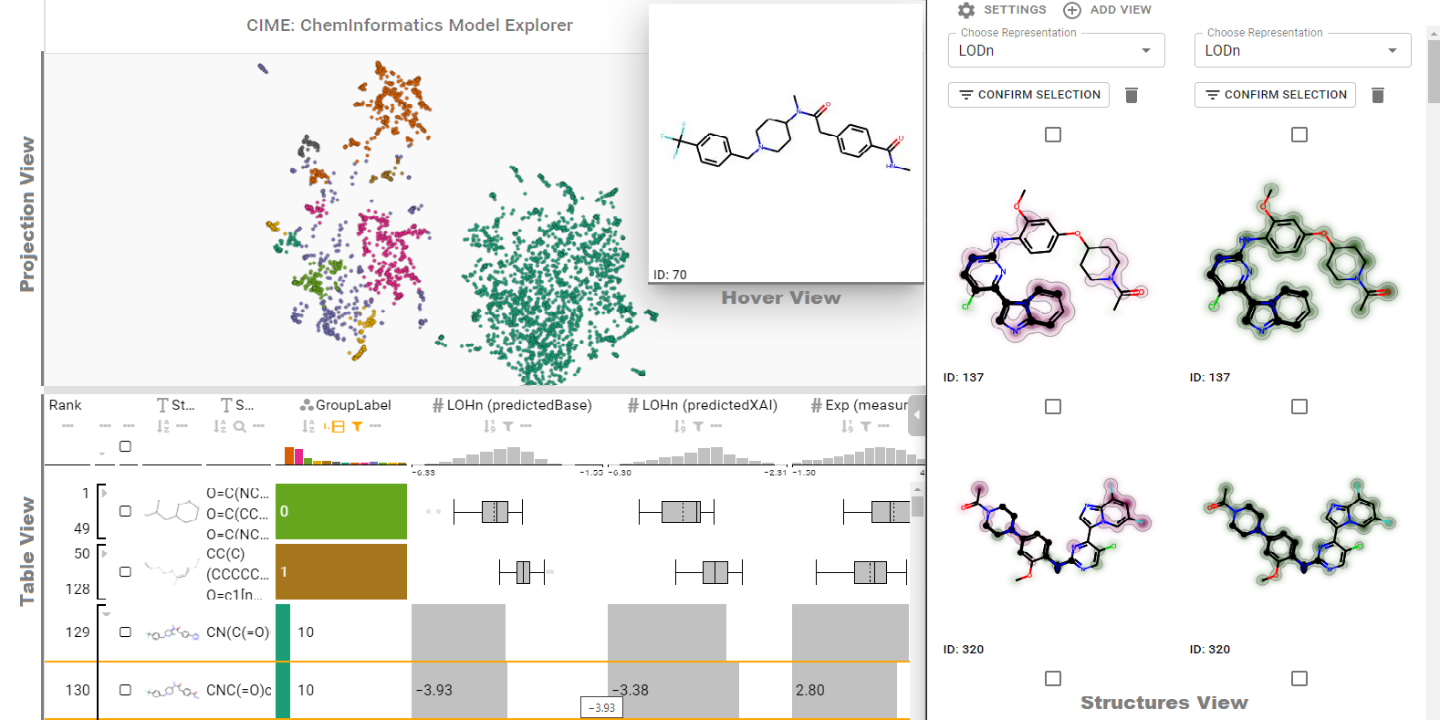
Chemical Data
Humer, C., Heberle, H., Montanari, F. et al. ChemInformatics Model Explorer (CIME): exploratory analysis of chemical model explanations. J Cheminform 14, 21 (2022).

Slide 25
Ongoing & Future Work
Comparing Embeddings

Slide 26
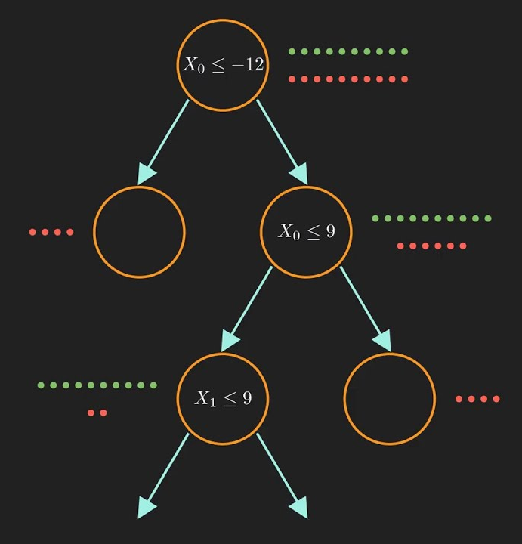
Ongoing & Future Work
Comparing Embeddings
Comparison by Attribute Combinations
…
…
Image source: https://www.youtube.com/watch?v=ZVR2Way4nwQ

Slide 27
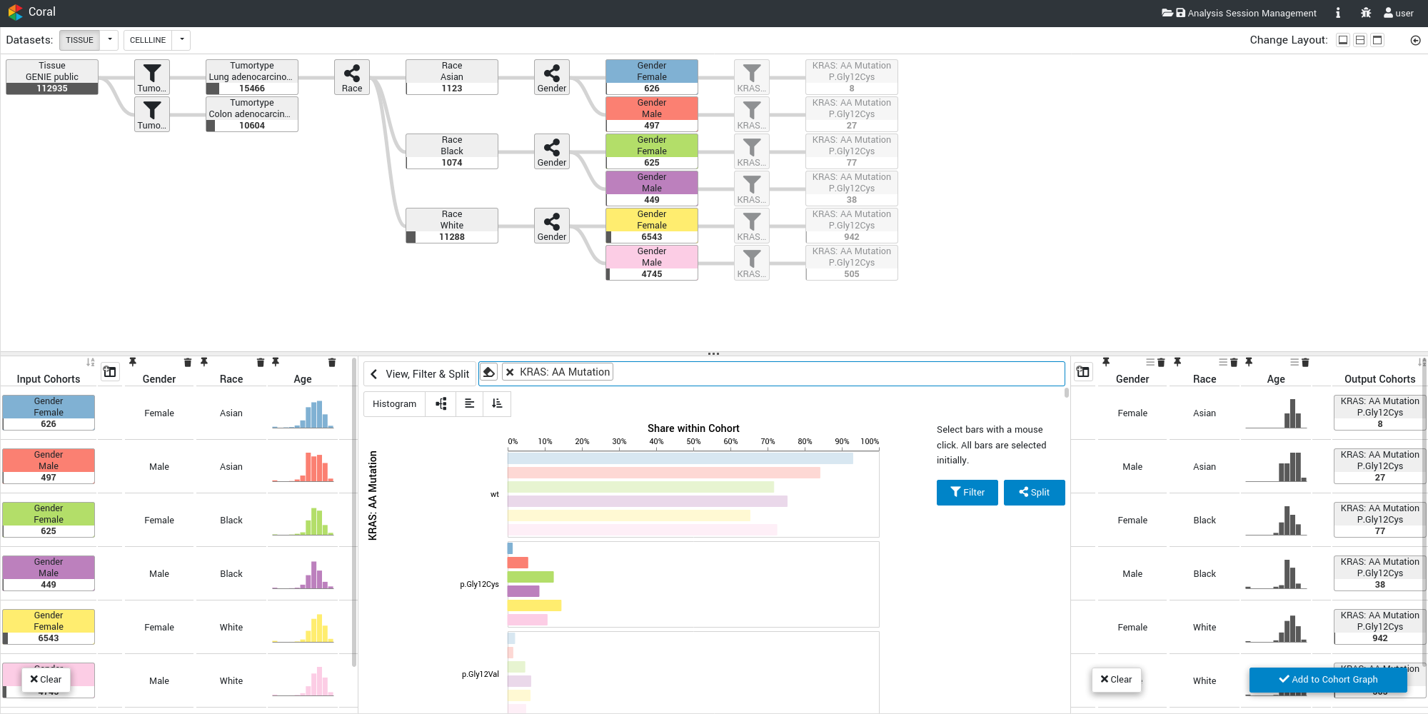
Ongoing & Future Work: Integration in Coral
P. Adelberger, K. Eckelt, M. J. Bauer, M. Streit, C. Haslinger, and T. Zichner, “Coral: a web-based visual analysis tool for creating and characterizing cohorts,” Bioinformatics, vol. 37, no. 23, pp. 4559–4561, Dec. 2021

Slide 28
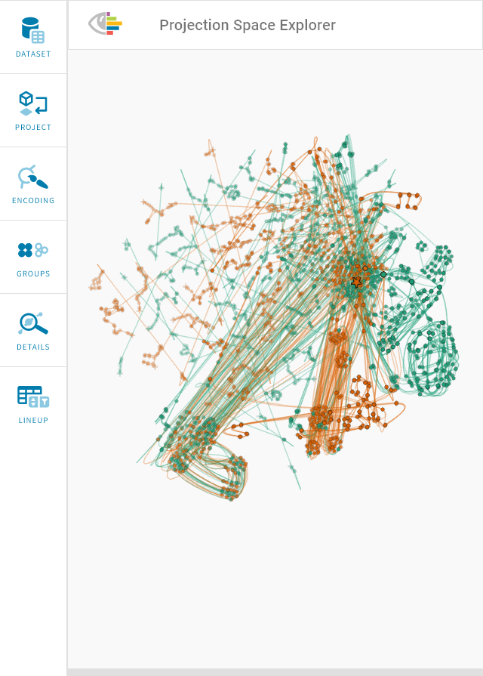
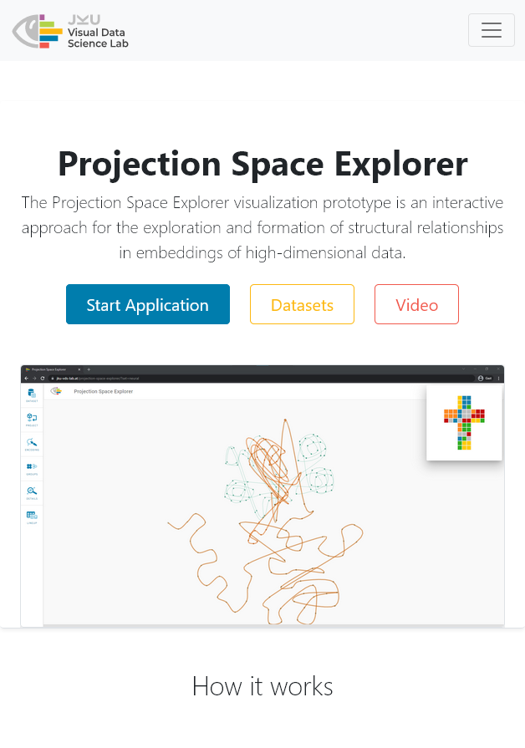
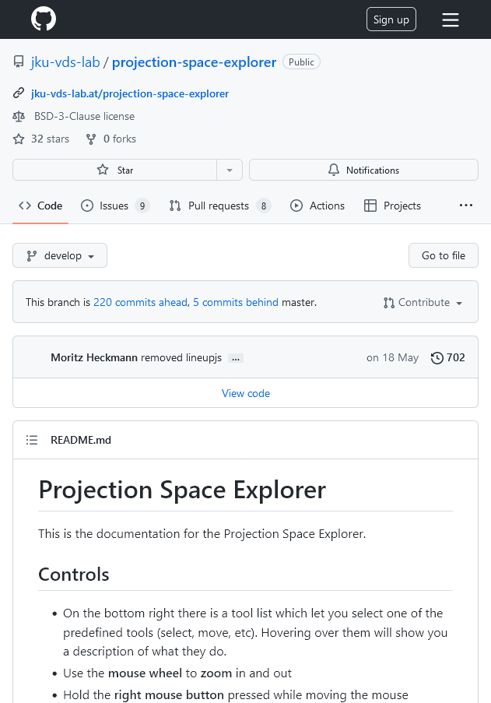
Overview
Online Tool
Library
https://jku-vds-lab.at/pse

Slide 29




Visual Exploration of Relationships and Structure in Low-Dimensional Embeddings
Klaus Eckelt, Andreas Hinterreiter, Patrick Adelberger, Conny Walchshofer, Vaishali Dhanoa, Christina Humer, Moritz Heckmann, Christian A. Steinparz, Marc Streit

Slide 30
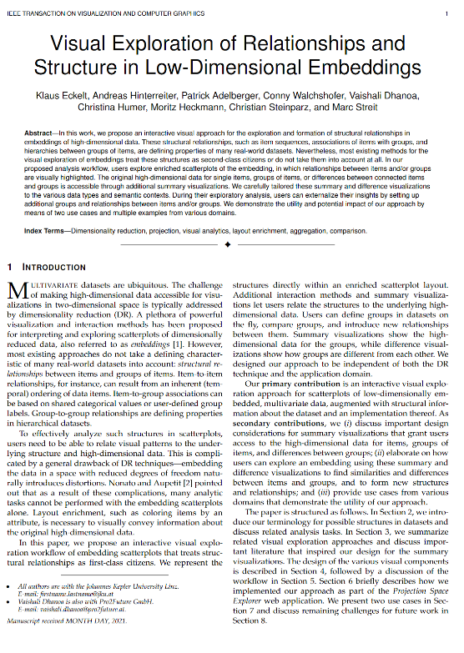
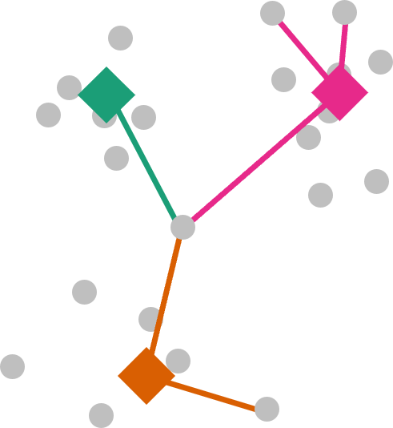
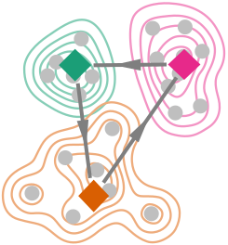
Visual Exploration of Relationships and Structure in Low-Dimensional Embeddings
Klaus Eckelt, Andreas Hinterreiter, Patrick Adelberger, Conny Walchshofer, Vaishali Dhanoa, Christina Humer, Moritz Heckmann, Christian A. Steinparz, Marc Streit
klaus.eckelt@jku.at
@klaus_lml
10.1109/TVCG.2022.3156760
https://jku-vds-lab.at/biovis22-eckelt

Slide 31

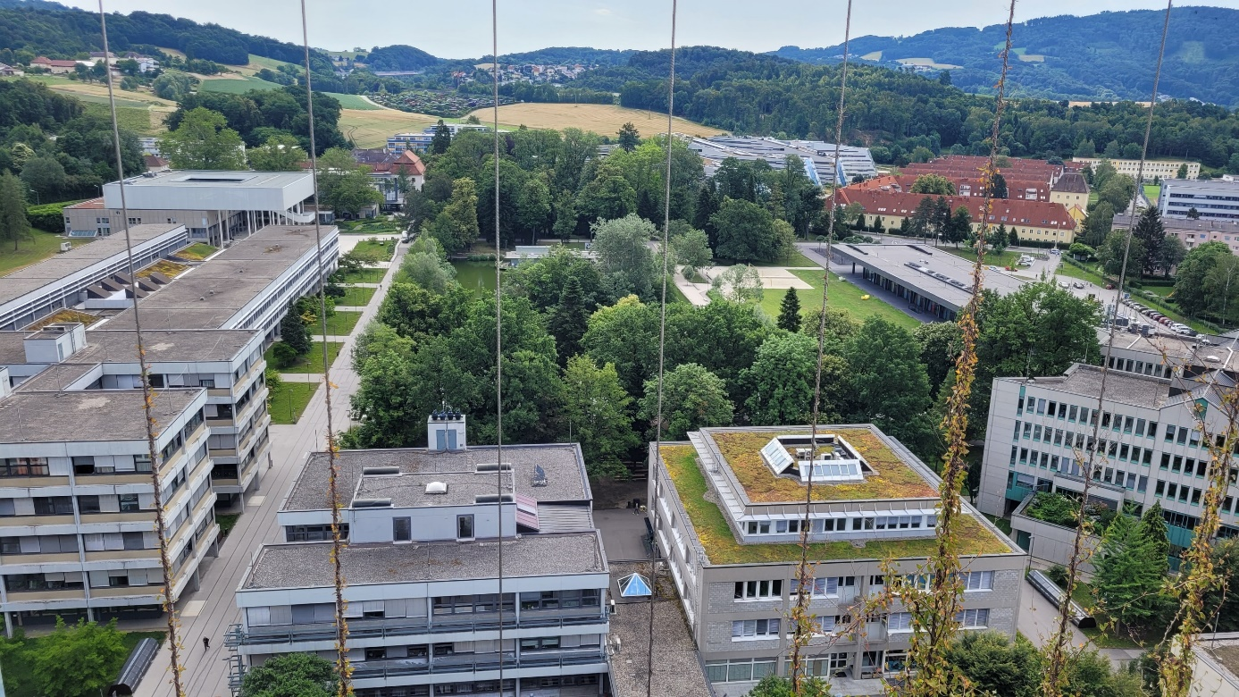
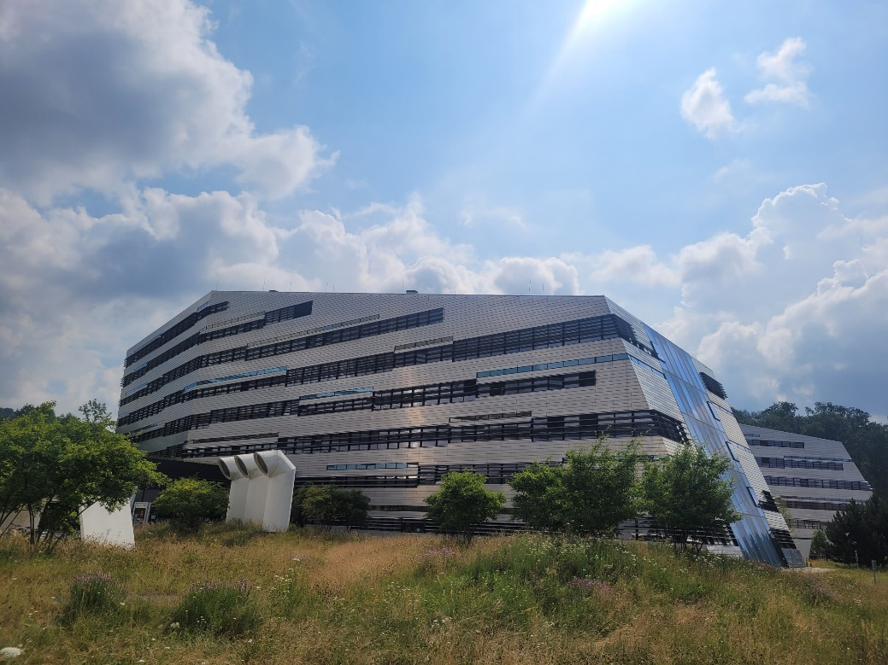

Slide 33
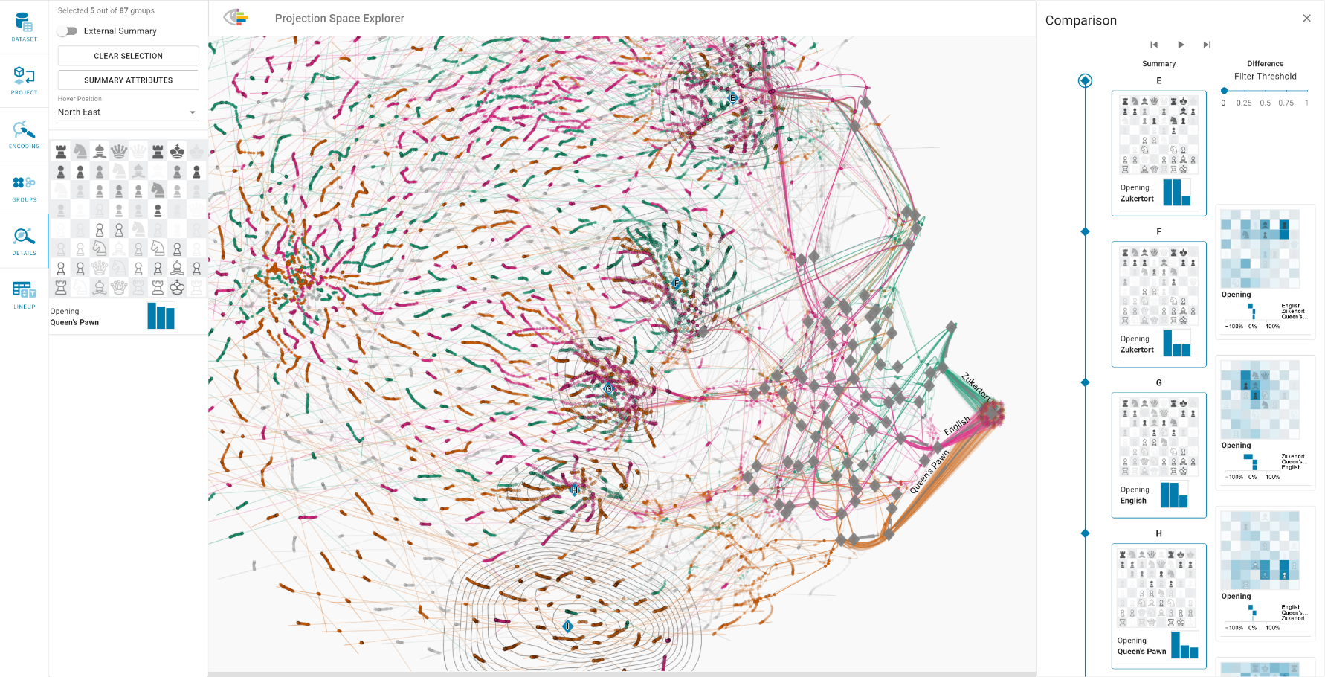
Scalability
Embedding is rendered with WebGL and scales well to 100 000 items
Chess: 100 000 items and 70 attributes
Cancer Genomics: 1238 items and 720 attributes

Slide 34
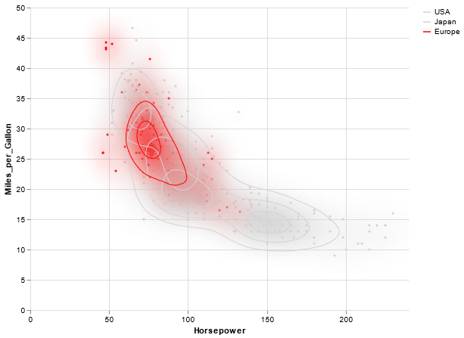
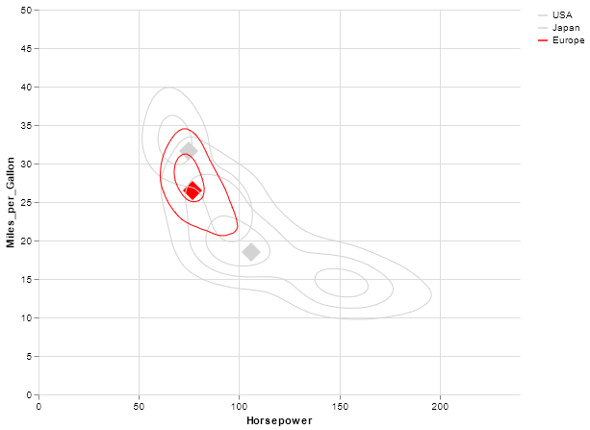
Encoding Group Distribution
Heatmap + Contours
Contours

Slide 35
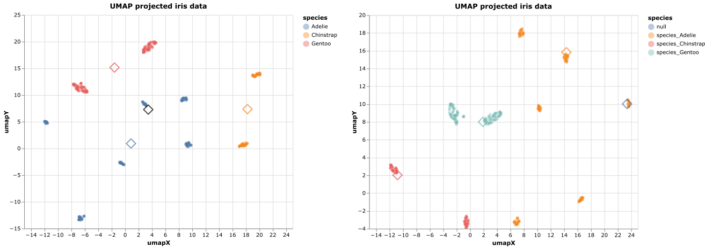
Centroid Positioning
Centroid
Medoid

Slide 36
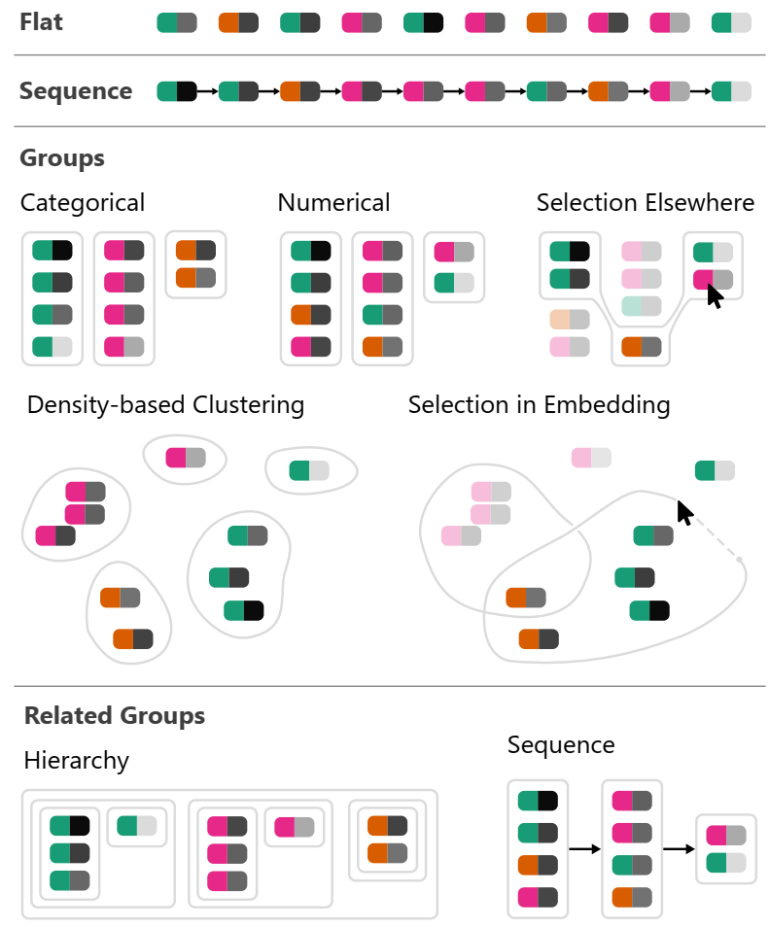
What Kind of Structure?
Single Items
Groups
data driven
user driven
density-based
Hierarchies

Slide 37
What Kind of Relationships?
Item Sequences
Hierarchies
Group Sequences
Graphs

